Slide 1
Data Visualization: Empowering Business with Effective Insights
By The Tata Group's

Slide 2
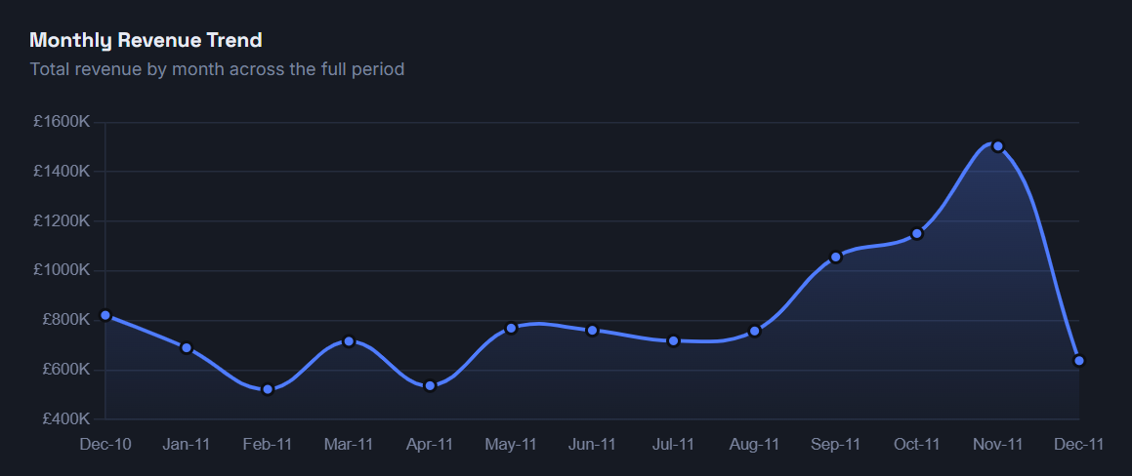
CEO Questions
1. What is the monthly trend of revenue, and which months faced the biggest increase/decrease?
Revenue remained relatively stable between January and August before rising sharply from September onward. The largest increase occurred between October and November, while the largest decrease occurred between November and December. However, December contains only partial-month data, so the decline may not reflect actual performance.
2. Which months generated the most revenue? Is there seasonality in sales?
November generated the highest revenue (£1.50M), followed by October and September. The strong rise in revenue during the final quarter suggests clear seasonality, likely driven by holiday shopping and year-end demand.

Slide 3
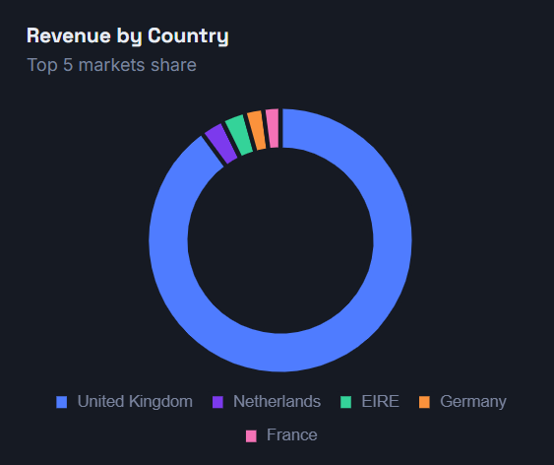
CEO Questions
3. Which region is generating the highest revenue, and which region is generating the lowest?
The generates the highest revenue UK (£285,446), followed closely by Netherlands (£283,141). EIRE generates the lowest revenue (£37,416). This indicates strong performance in Western Europe while some international markets contribute significantly less and may require growth strategies.

Slide 4
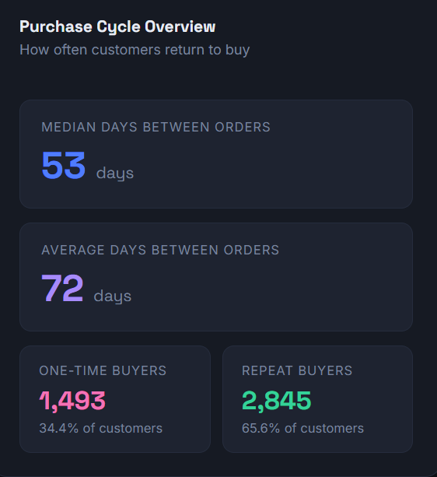
Questions of interest to the CMO
1. What is the percentage of customers who are repeating their orders? Are they ordering the same products or different?
Total Customers: 4,338
Repeat Customers: 2,845
Repeat Customer Rate: ~65.6%
2. For the repeat customers, how long does it take for them to place the next order after being delivered the previous one?
The most repeat customers place their next order within 72 days of their previous purchase, with the highest concentration occurring in the first few weeks.

Slide 5
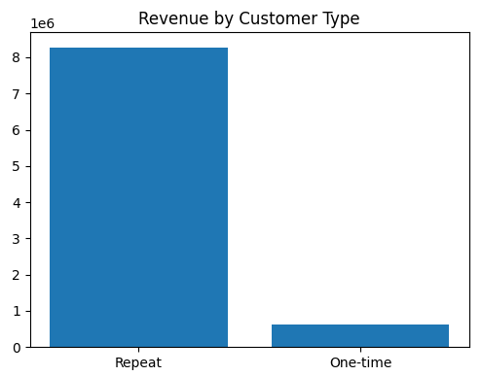
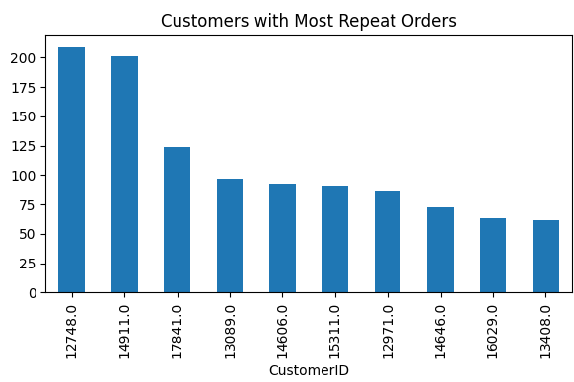
Questions of interest to the CMO
3. What revenue is being generated from the customers who have ordered more than once?
The revenue analysis shows that repeat customers generate the vast majority of the company's revenue, contributing approximately £8.2 million, while one-time customers contribute only about £0.6 million. This demonstrates that customer retention is a key driver of business performance, and maintaining strong relationships with repeat buyers should remain a priority for the marketing team.
4. Who are the customers that have repeated the most? How much are they contributing to revenue?
The customers with the highest number of repeat orders are Customer IDs 12748 and 14911, followed by 17841, 13089, and 14606. These customers place substantially more orders than the average customer and are likely significant contributors to overall revenue.

